Slide 1

ANISHA A
FINAL PROJECT
- Object Detection and Recognition

Slide 2
2
PROJECT TITLE
OBJECT DETECTION AND RECOGNITION USING GAN

Slide 3
3
AGENDA
1
Our project aims to explore the integration of Generative Adversarial Networks (GANs) into object detection frameworks. We will begin with a literature review to understand existing methodologies and challenges.
2
we will train a GAN model with the dataset to generate synthetic images for data augmentation. Then, we will integrate these generated images into an object detection framework, evaluating performance against traditional methods.
3
project will conclude with an analysis of results, identification of limitations, and suggestions for future research directions

Slide 4
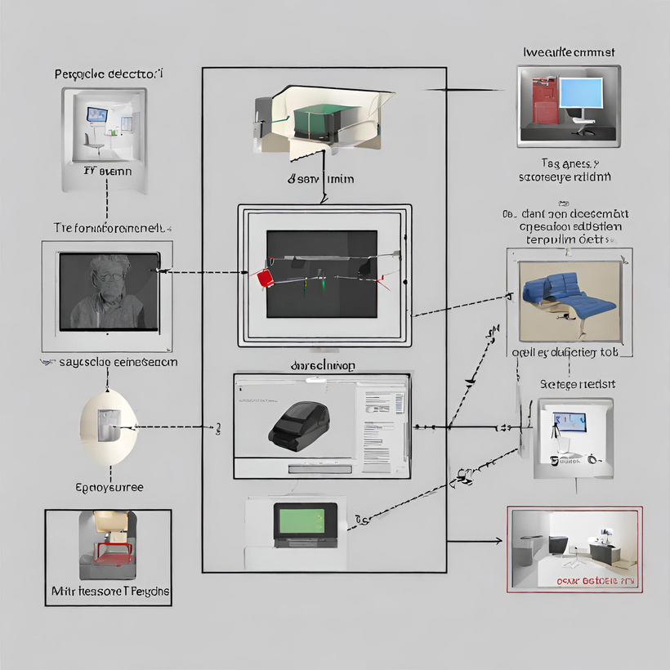
4
PROBLEM STATEMENT
This project aims to develop a Generative Adversarial Network (GAN) capable of detecting/recognizing objects resembling those from the MINST dataset .
The objective produce a reliable object detection algorithm.

Slide 5
5
PROJECT OVERVIEW
Our project aims to leverage the capabilities of Generative Adversarial Networks (GANs) to enhance object detection systems.
The core of our project involves training a GAN model to generate synthetic images that closely resemble real-world objects
We will assess the impact of GAN-generated data on the performance of the object detection system, considering metrics such as accuracy, precision, and computational efficiency.
Through rigorous experimentation and analysis, we aim to provide insights into the effectiveness of GAN-based augmentation for object detection tasks.

Slide 6
6
END USERS
Academics
Researchers
cyber security professionals
Robotics
software developers
industry professionals
Traffic controllers

Slide 7
6
SOLUTION AND IT’S VALUE PROPORTION
Solution
The proposed solution integrates Generative Adversarial Networks (GANs) into object detection frameworks to enhance accuracy, reduce data annotation costs, and improve robustness against adversarial attacks. By generating synthetic images, the model is trained on a more diverse dataset, enabling better generalization and adaptability to real-world scenarios. This approach offers a cost-effective and efficient way to augment object detection systems, providing improved performance and resilience in various application domains.

Slide 8
8
VALUE PROPORTION - CONTINUATION
1
Enhanced Accuracy and Robustness: Integrating GANs diversifies the training dataset, improving accuracy and robustness in object detection by better handling real-world variations.
2
GAN-generated synthetic images reduce reliance on manual data annotation, leading to significant cost savings while ensuring a comprehensive training dataset.
3
GAN-based training enhances the model's ability to distinguish genuine objects from adversarial perturbations, bolstering system security.

Slide 9
9
UNIQUENESS IN SOLUTION
Adversarial Training for Robustness:
This approach enhances the model's robustness against adversarial attacks, a critical aspect often overlooked in conventional object detection pipelines.
Cost-Efficient Solution with High Performance:
By reducing the need for manual annotation and utilizing synthetic data generation, it significantly lowers the overall costs associated with dataset creation while maintaining high performance in object detection tasks.

Slide 10
10
MODELLING
Data Collection and Preprocessing:
GAN Training:
Architecture Selection, Training GAN and Evaluation.
data selection and data pre-processing
Object Detection Model Integration:
Optimization and Deployment:
Model Selection, Dataset Augmentation, Fitting the model and Evaluation
Optimization, Teating and Evaluation, Deployment and Maintainance

Slide 11
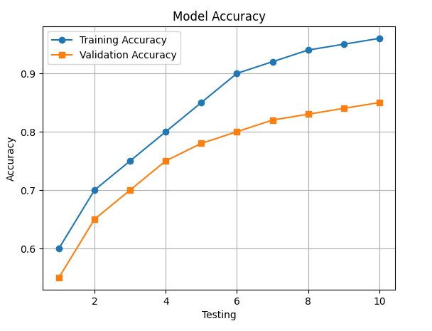
11
﻿RESULT
ACCURACY GRAPH
Model Output:
Detected Object: "BOOK" (89.72%)

Slide 12
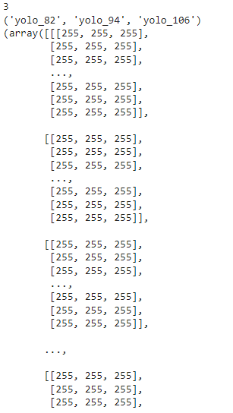
OUTPUT:
ARRAY REPRESENTATION OF THE DETECTED IMAGE OBJECTS

Slide 13
THANK YOU
Presented By : ANISHA AMALRAJ

